Slide 1



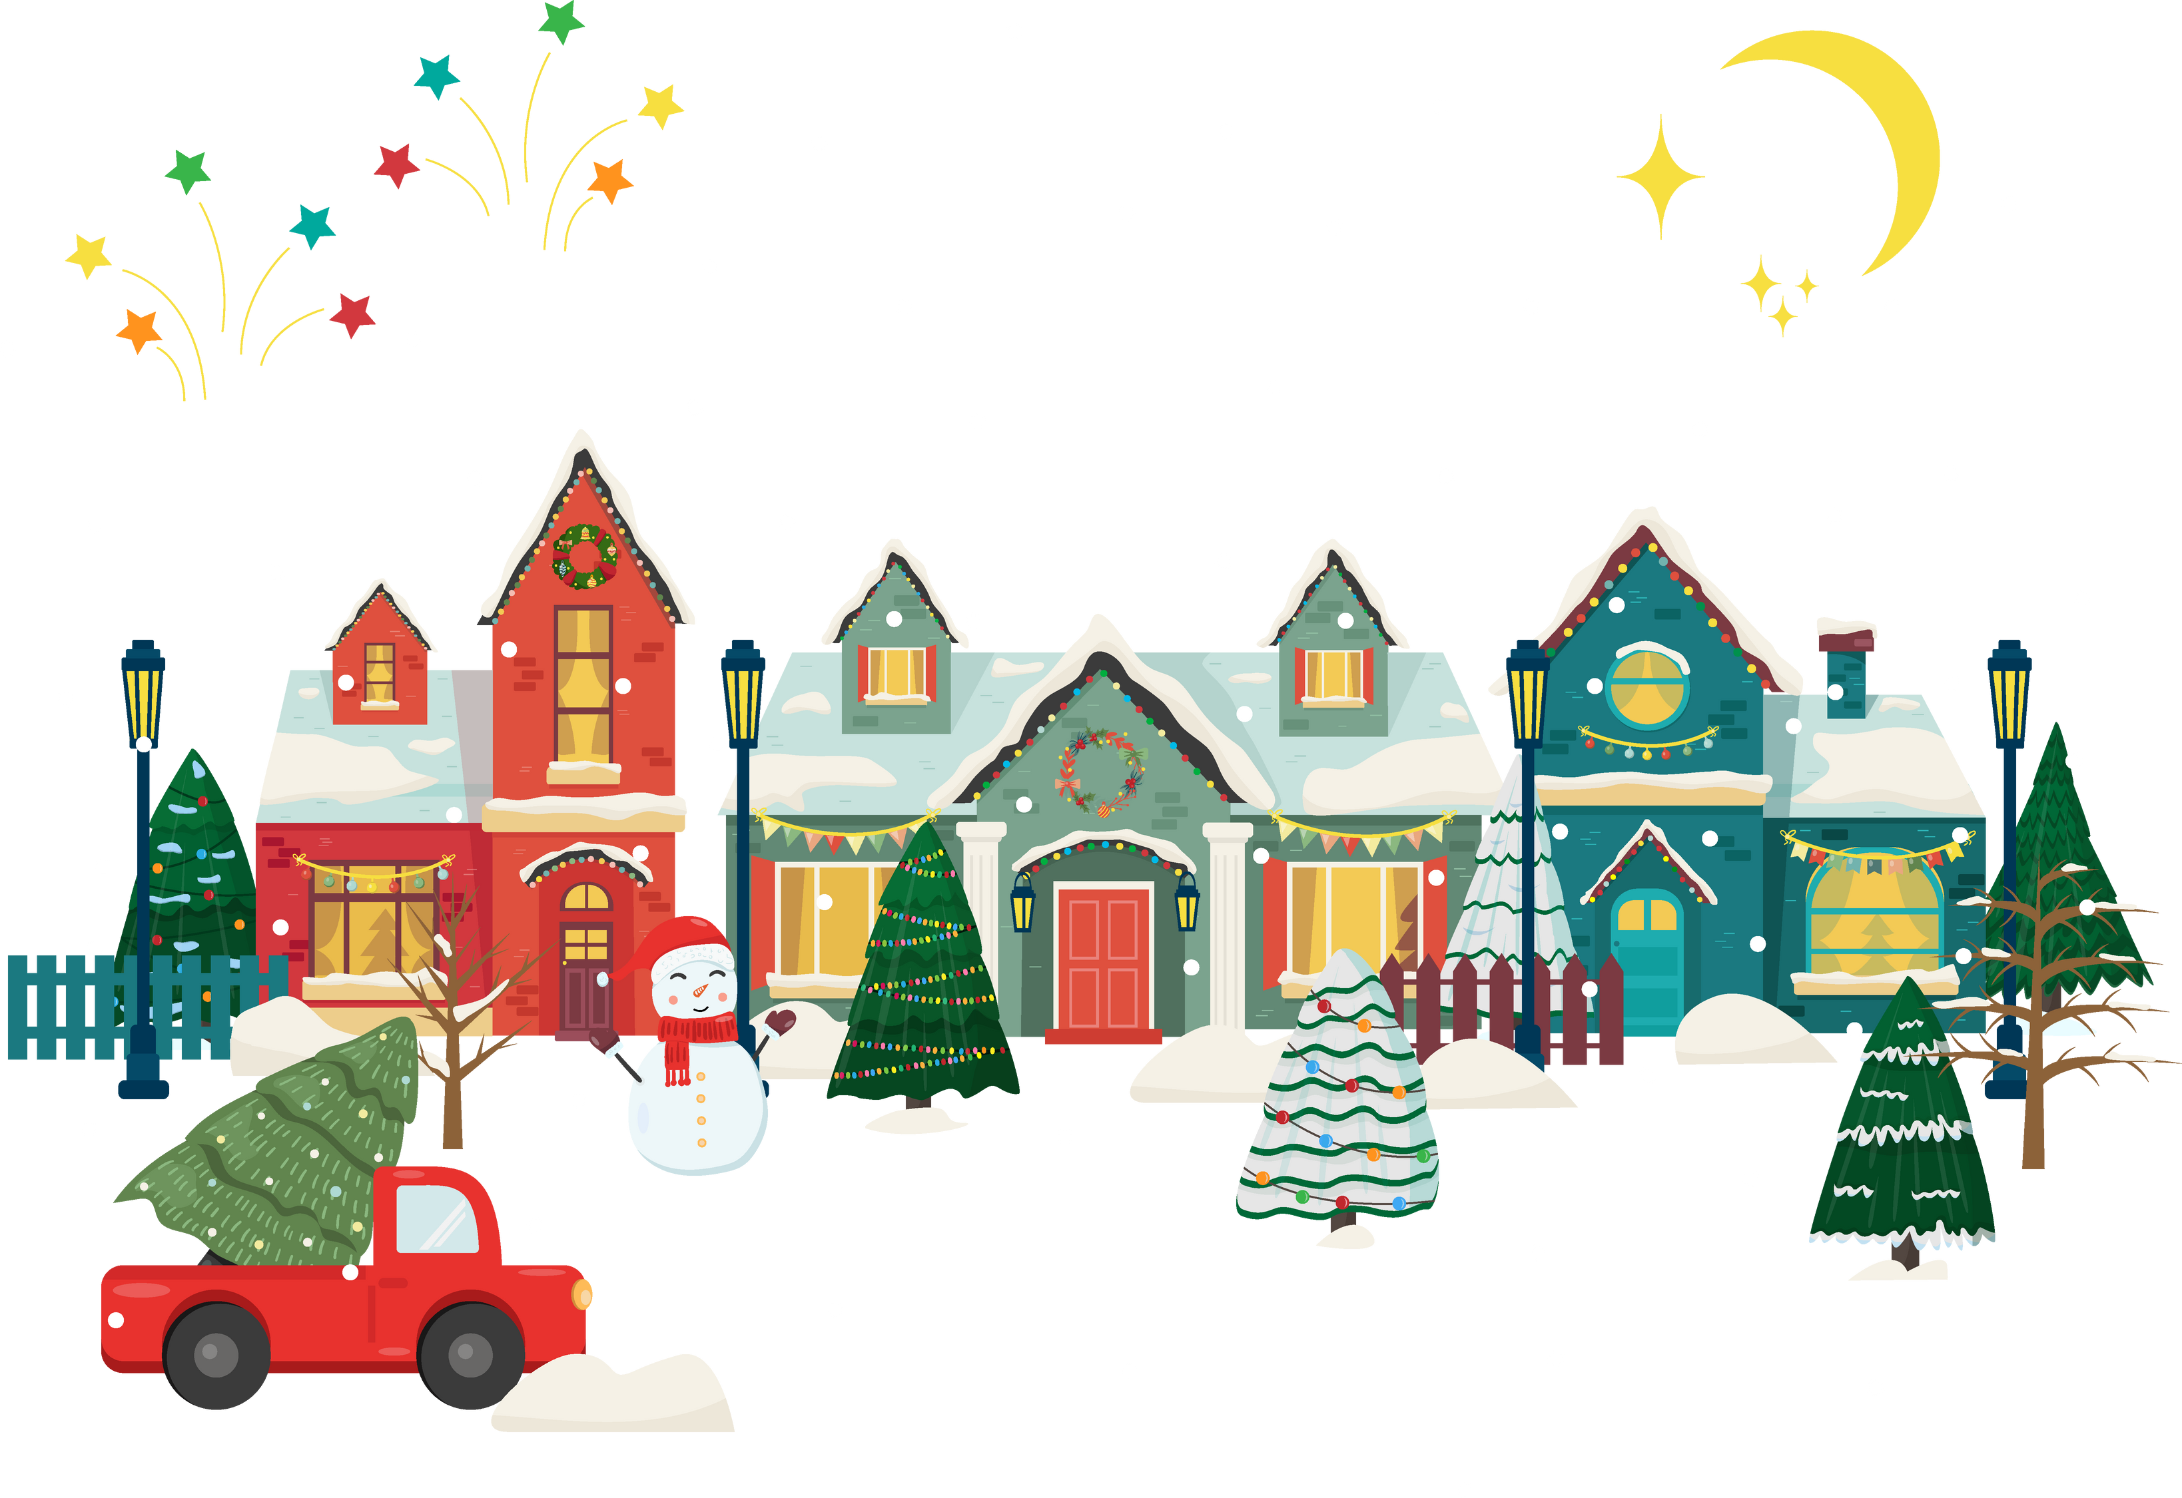

Carpentersville’s
HOLIDAY LIGHTING CONTEST

Slide 2








CATEGORIES
SMALL
SPACE
CLARK W.
GRISWOLD
TRADITIONAL
ROCKIN’
AROUND THE
CHRISTMAS TREE
PEOPLE’S
CHOICE
FACEBOOK

Slide 3



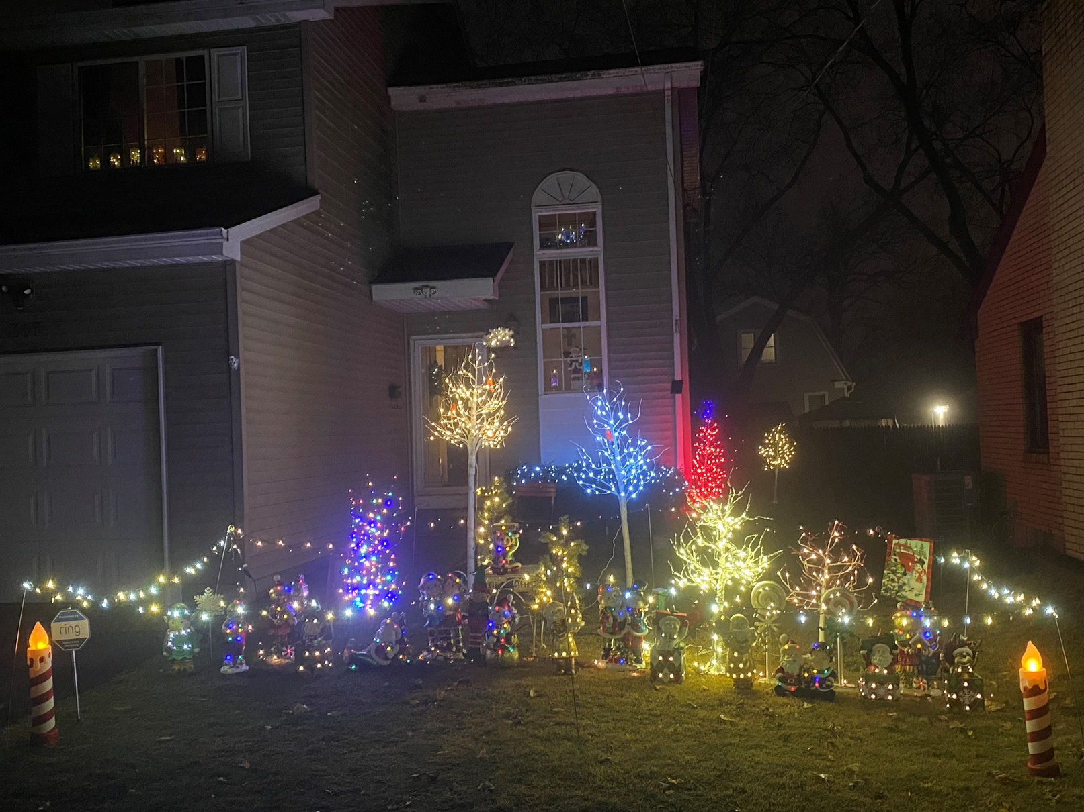

SMALL SPACE
2024
317 N GREEN ST

Slide 4

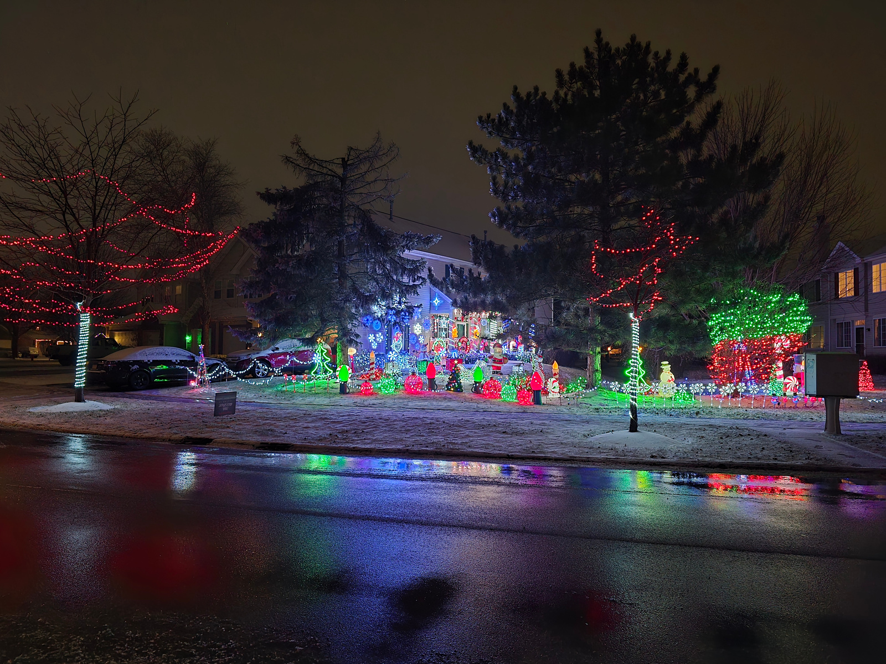
SMALL SPACE
2024
7348 GRANDVIEW CT

Slide 5
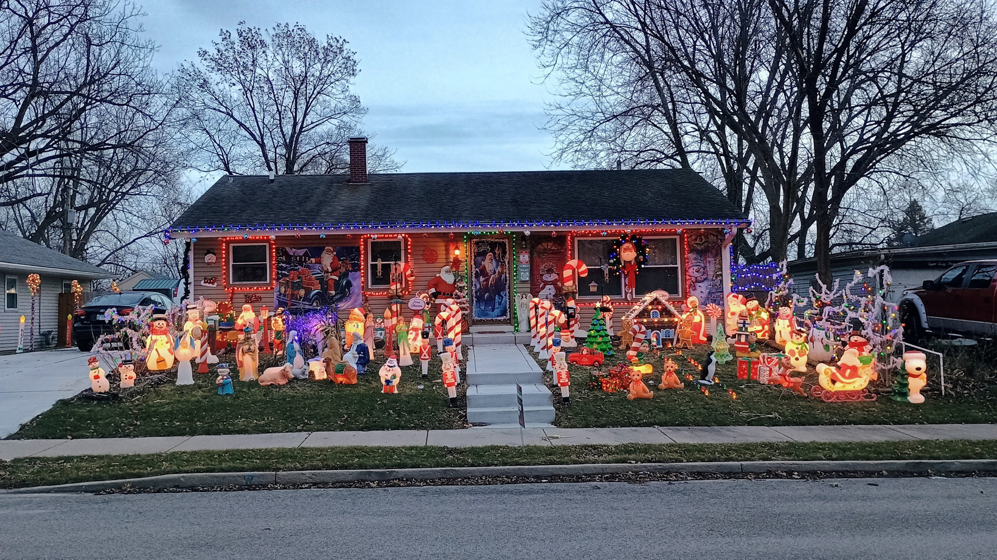

TRADITIONAL
2024
841 NAVAJO DR

Slide 6
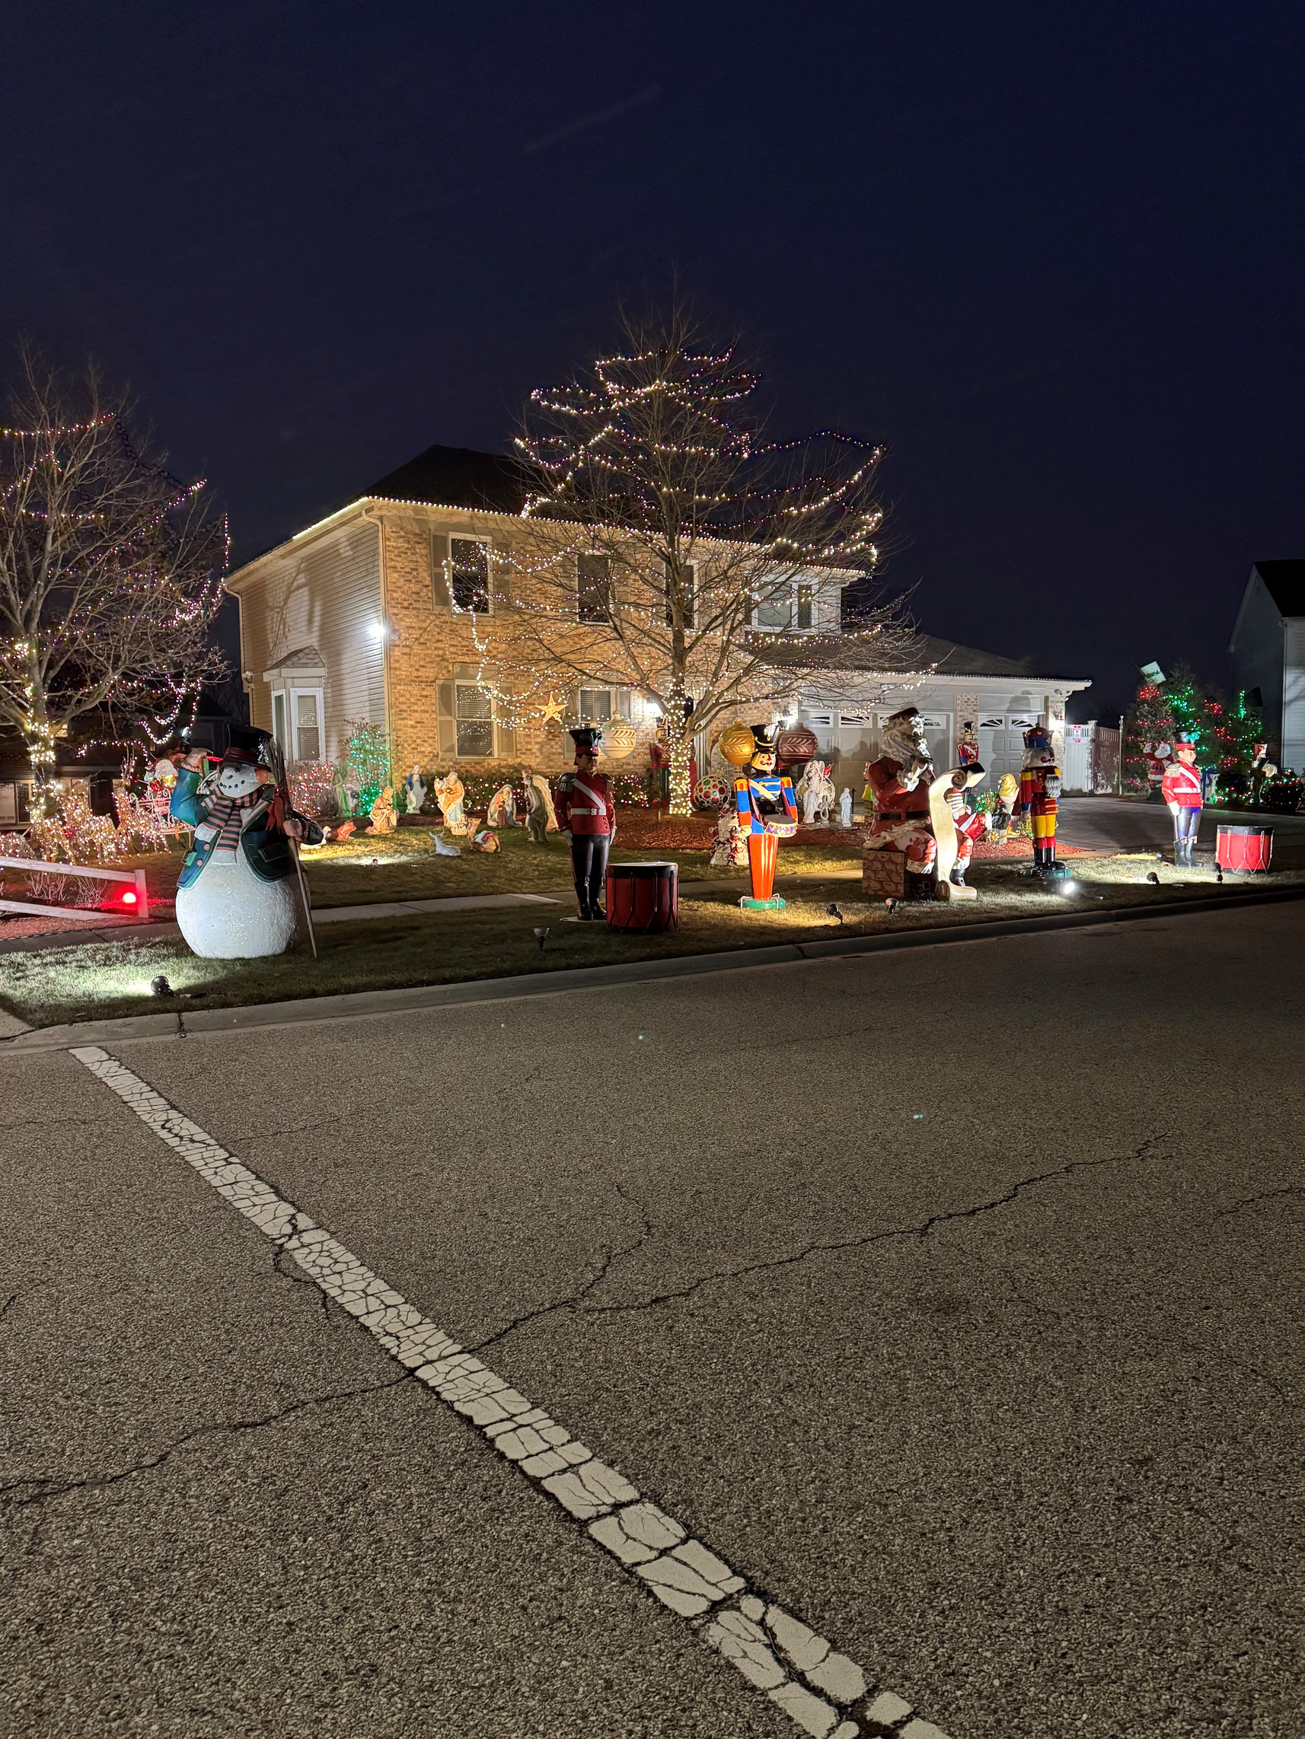
TRADITIONAL
2024
102 PORT COVE

Slide 7
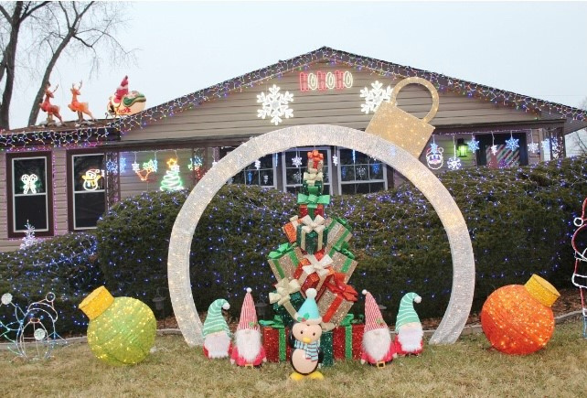

CLARK W. GRISWOLD
2024
812 SALEM LN

Slide 8
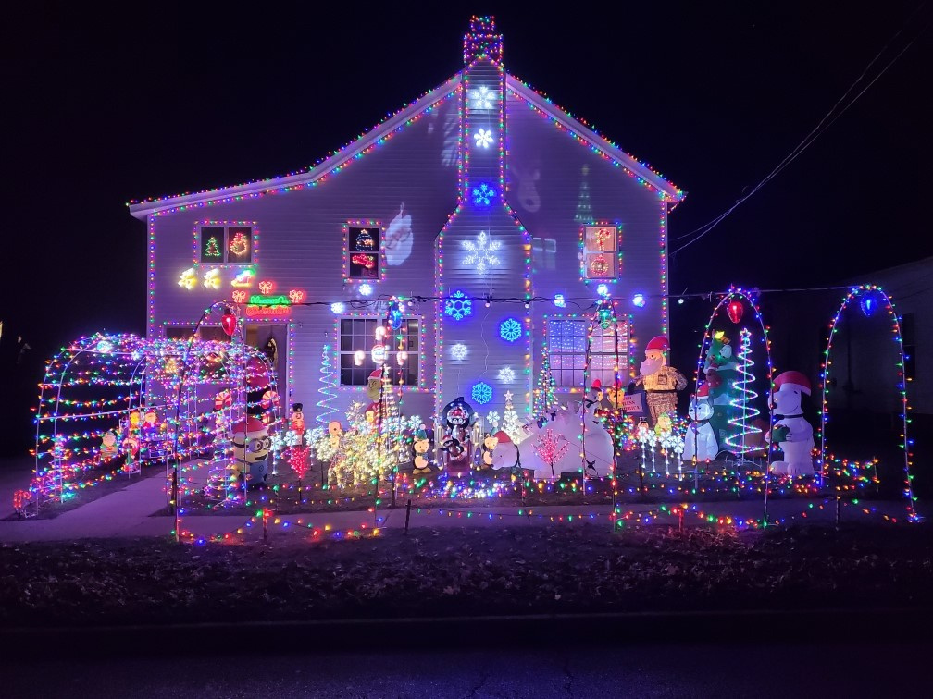
CLARK W. GRISWOLD
2024
310 N WASHINGTON ST

Slide 9
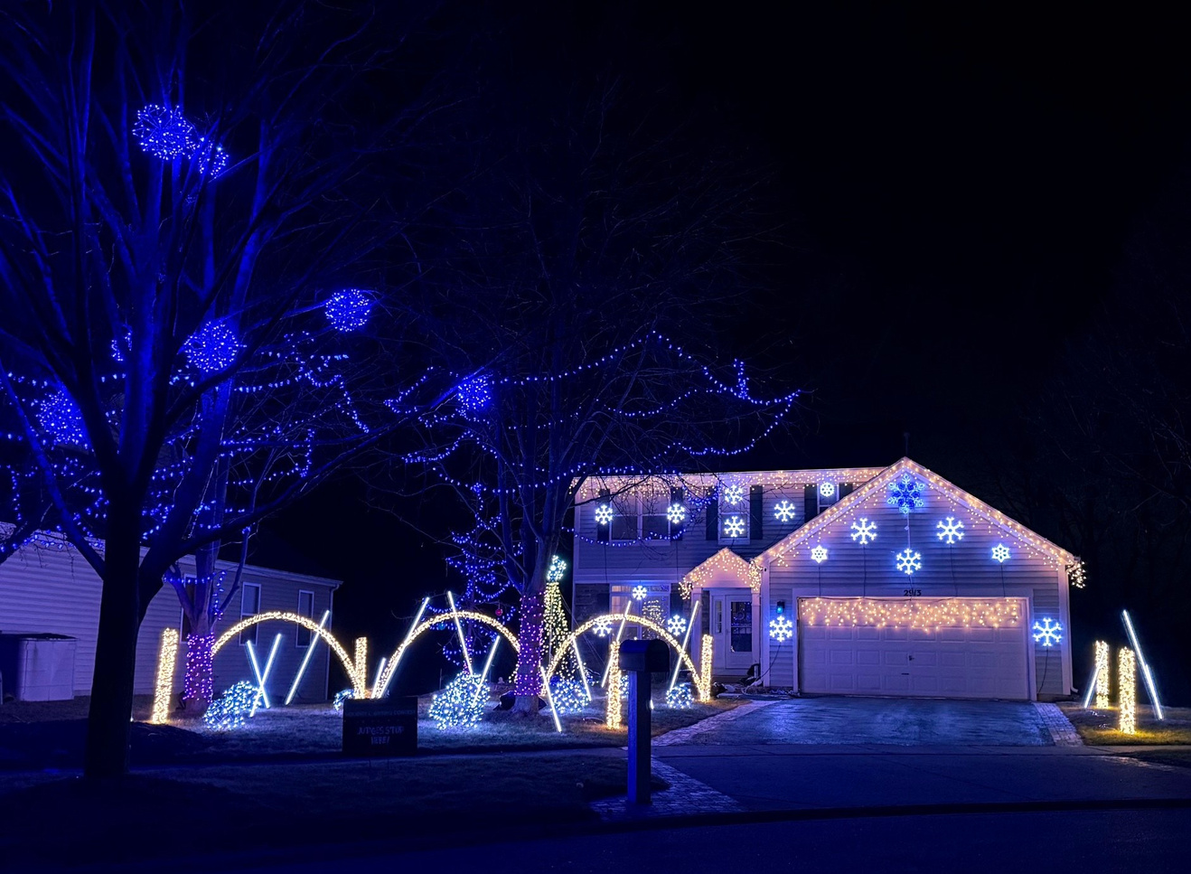

ROCKIN’ AROUND THE CHRISTAMS TREE
2024
2913 DEERPATH LN

Slide 10
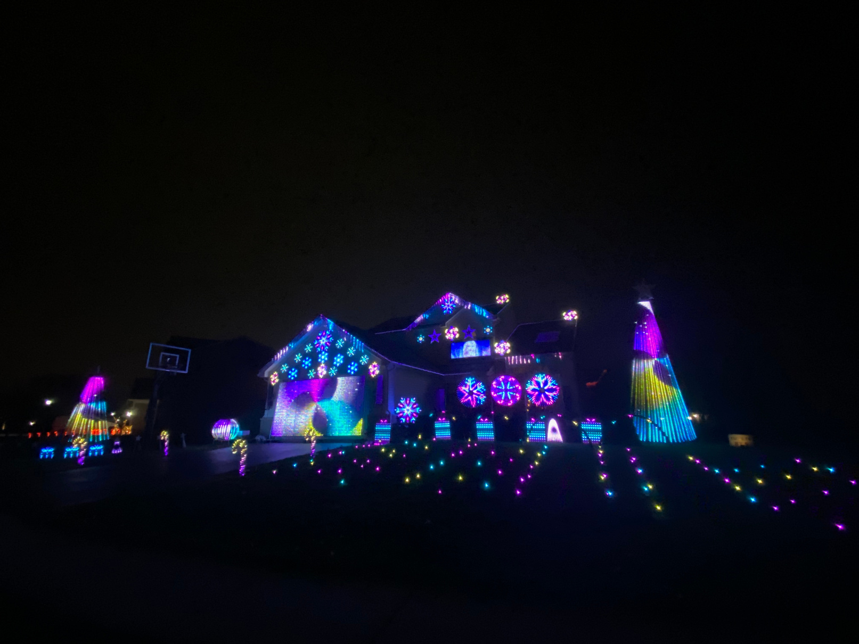
ROCKIN’ AROUND THE CHRISTAMS TREE
2024
2403 WOODSIDE DR

Slide 11
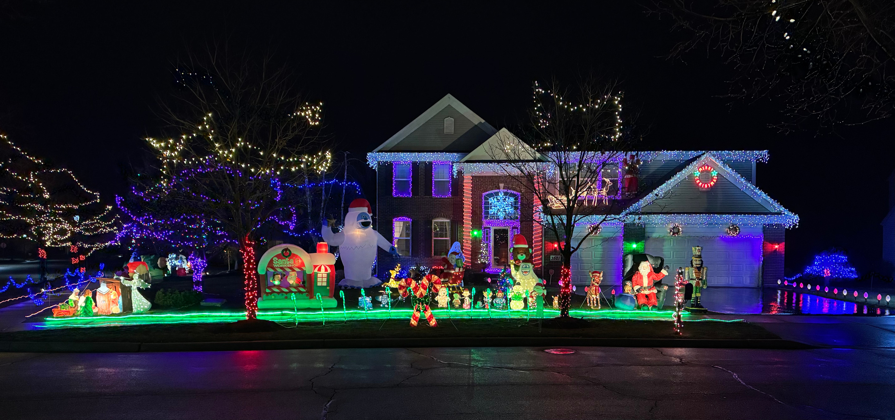
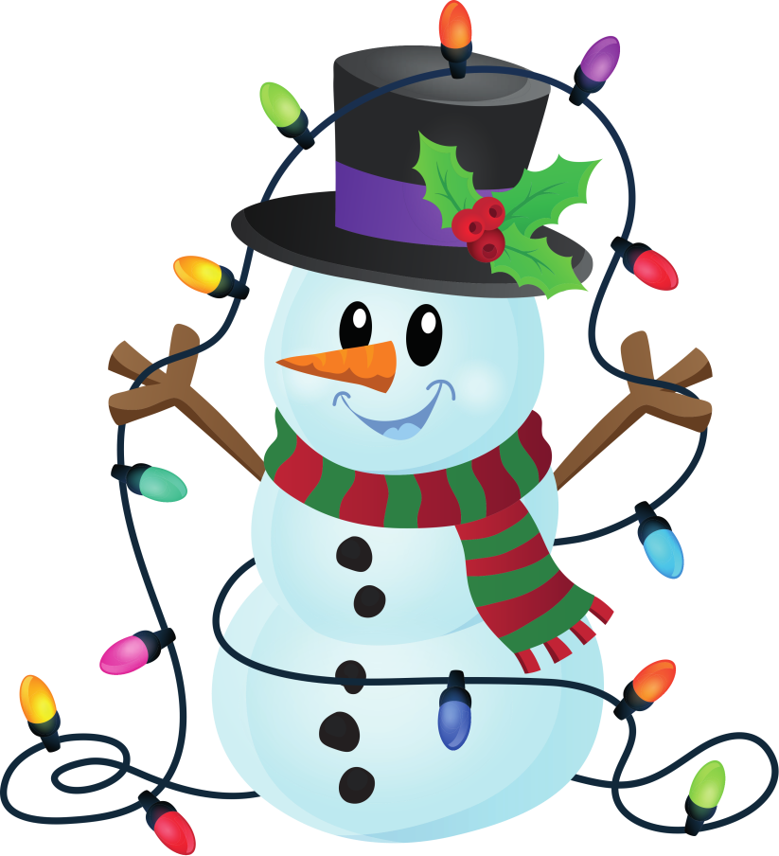
PEOPLE’S CHOICE
FACEBOOK
2024
3521 CARLISLE LANE

Slide 12



  THANK YOU!
  CONGRATULATIONS TO ALL OF THE WINNERS AND PARTICIPANTS!

