Slide 1


Slide 2
ROOKIE

Slide 3

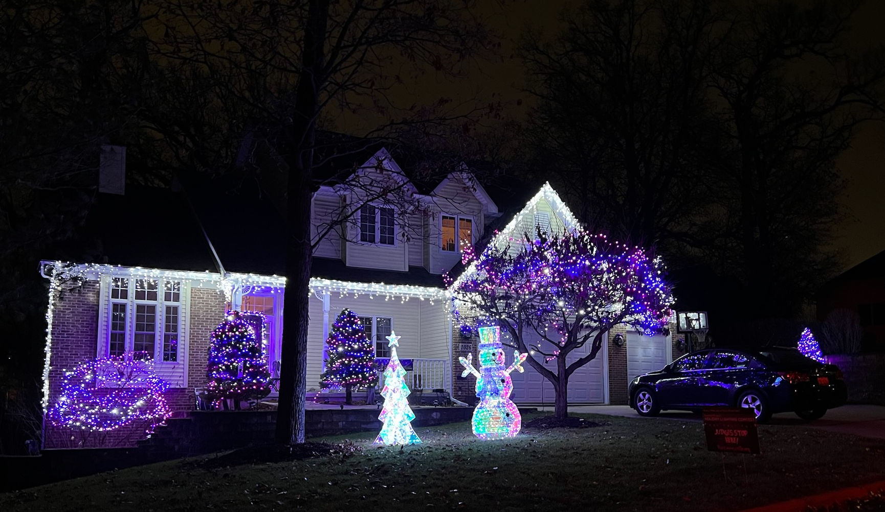
ROOKIE
1026 Rosewood

Slide 4

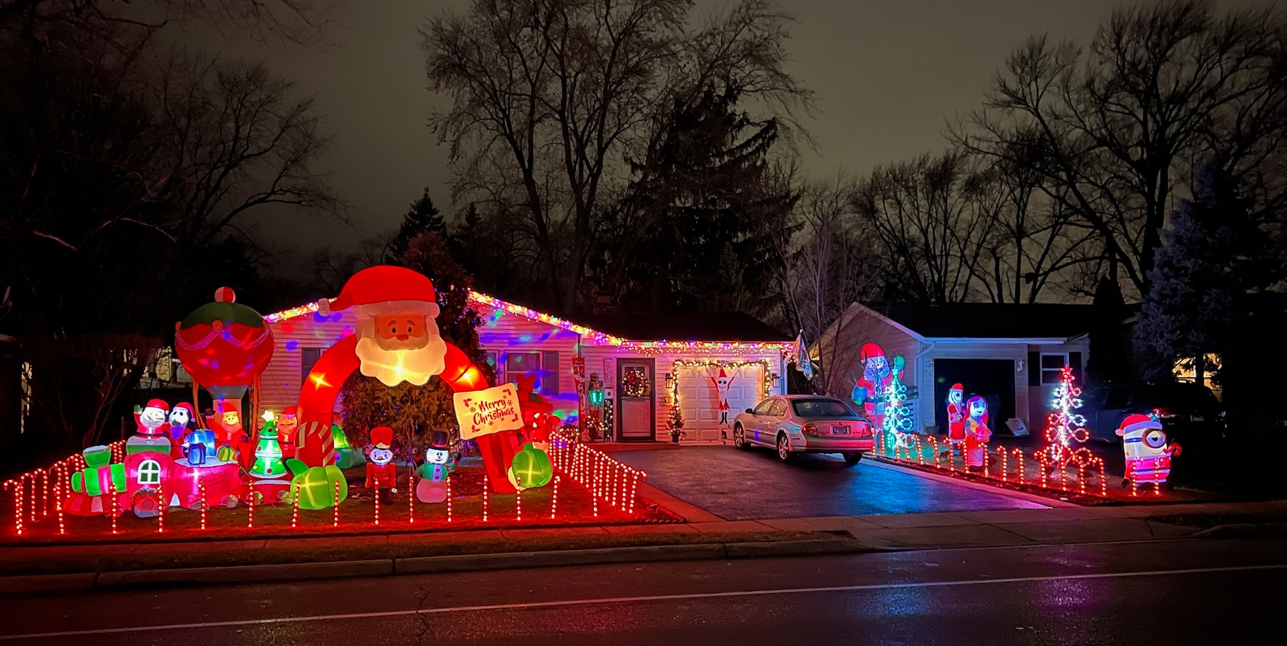
ROOKIE
327 Tulsa

Slide 5

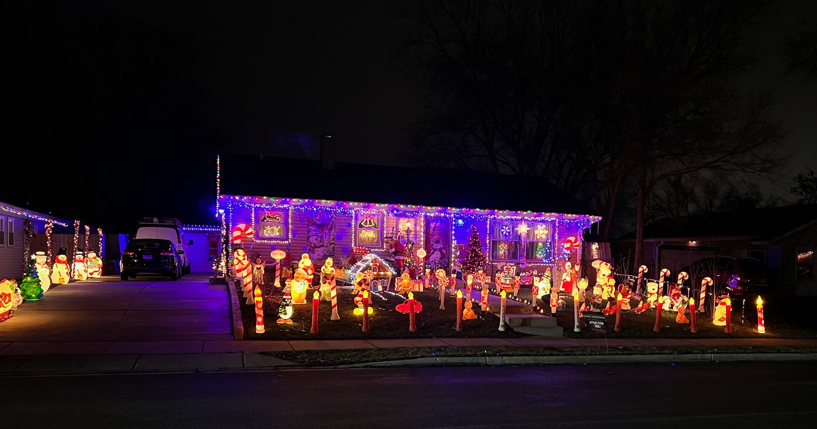

ROOKIE
841 Navajo

Slide 6
TRADITIONAL

Slide 7
TRADITIONAL
812 Salem

Slide 8
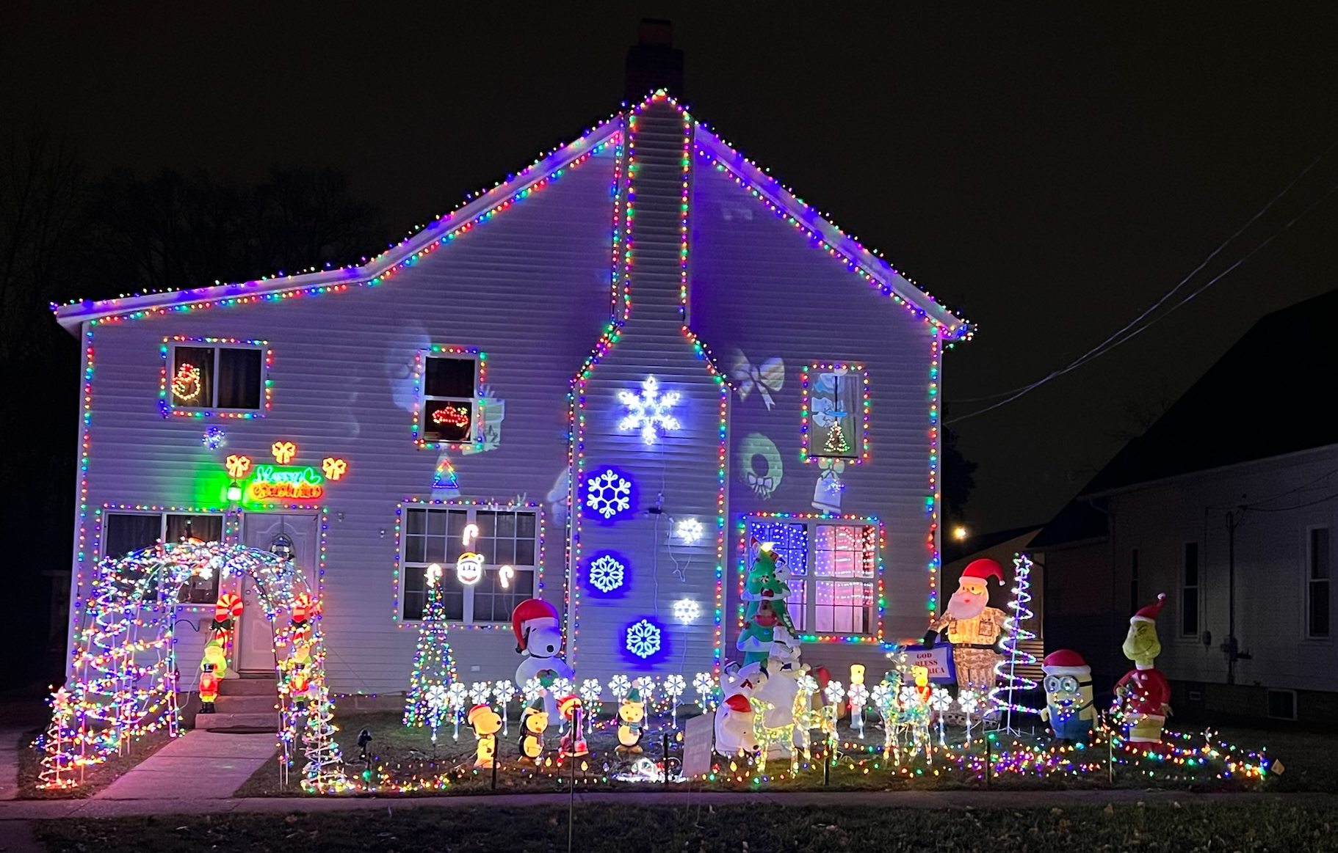
TRADITIONAL
310 N Washington

Slide 9
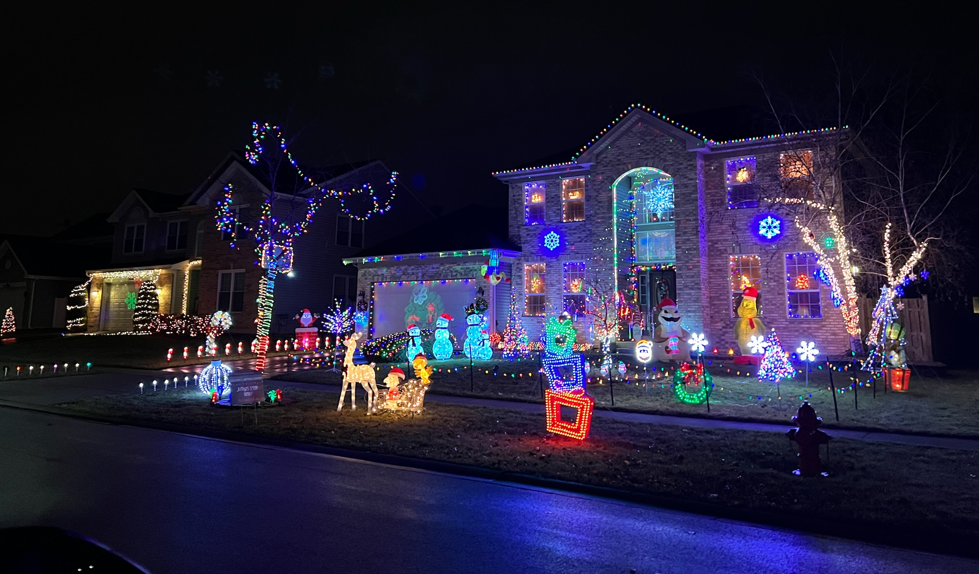
TRADITIONAL
7044 Westwood

Slide 10
CLARK W. GRISWOLD

Slide 11
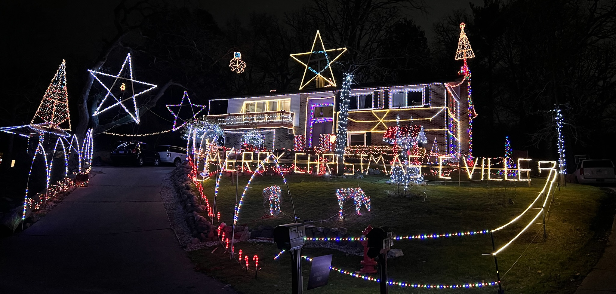
GRISWOLD
534 Wilmette Ave

Slide 12
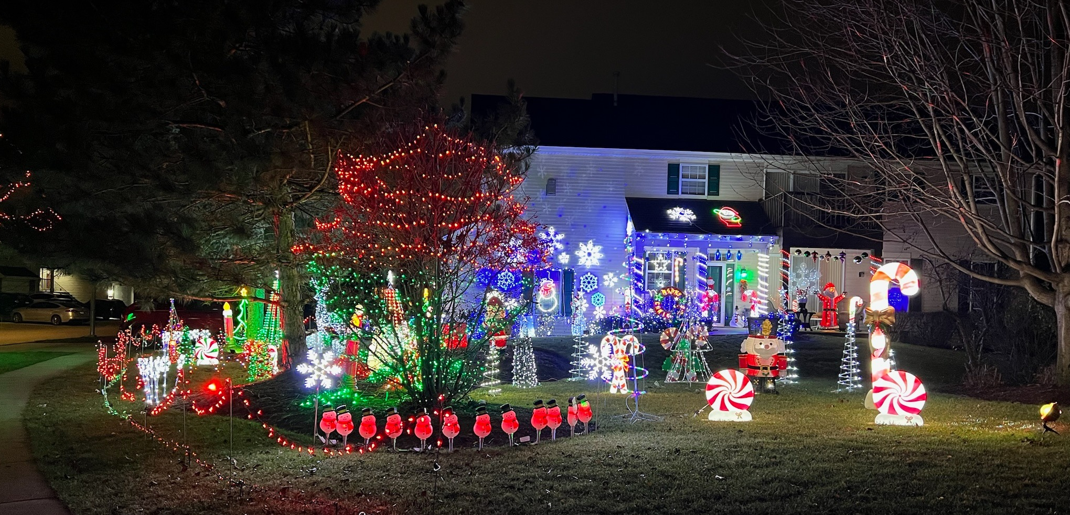
GRISWOLD
7348 Grandview Ct

Slide 13
GRISWOLD
102 Port Cove

Slide 14

CARPENTERSVILLE TODAY
HOLIDAY LIGHTING CONTEST
WINNER!

Slide 15
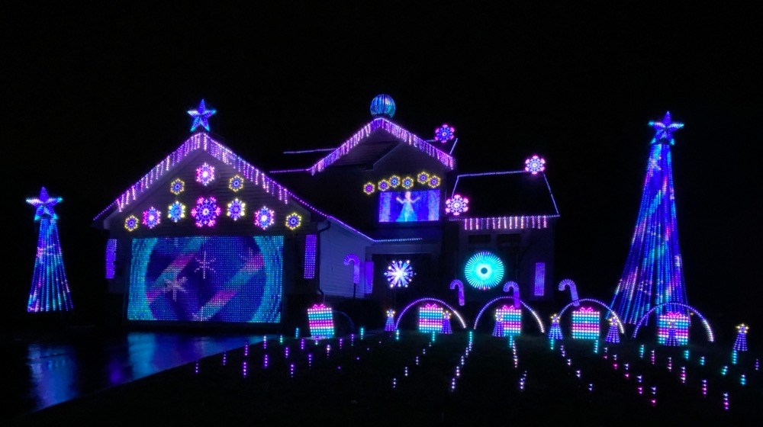
FACEBOOK WINNER
2403 WOODSIDE DRIVE

